Slide 1
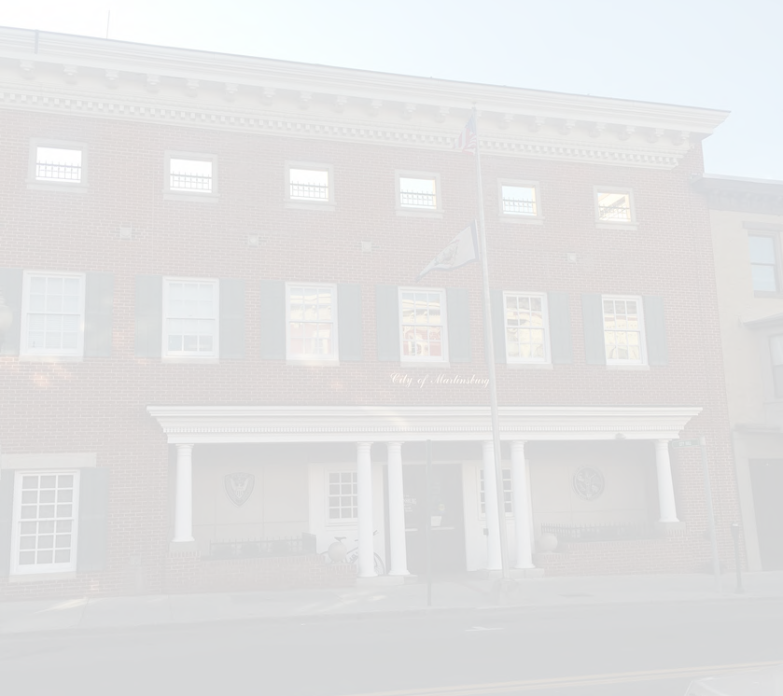
CITY OF MARTINSBURG
RACE + COMMERCE PARKING LOT / PARK
MARTINSBURG, WEST VIRGINIA
MAY 17, 2021

Slide 2
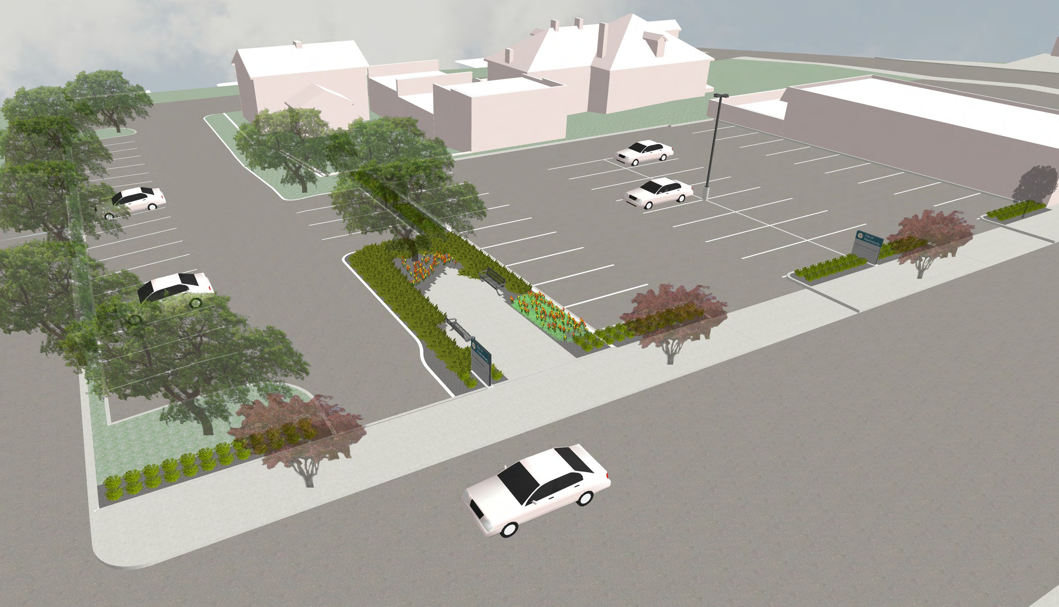
OPTION A

Slide 3
23
36
CITY NUMBERED
PARKING SPACES
PUBLIC METERED PARKING SPACES
OPTION A

Slide 4
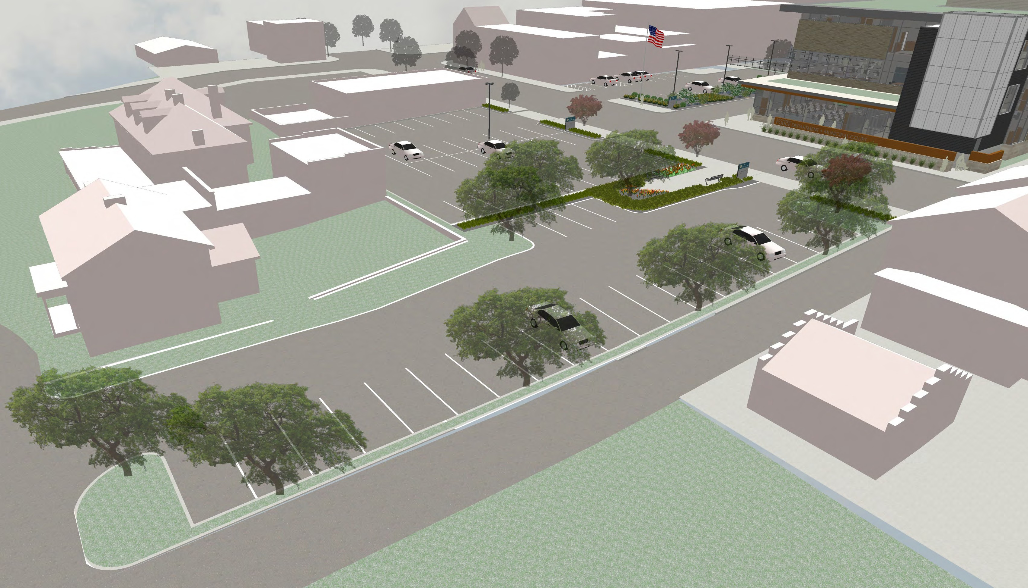
OPTION A

Slide 5
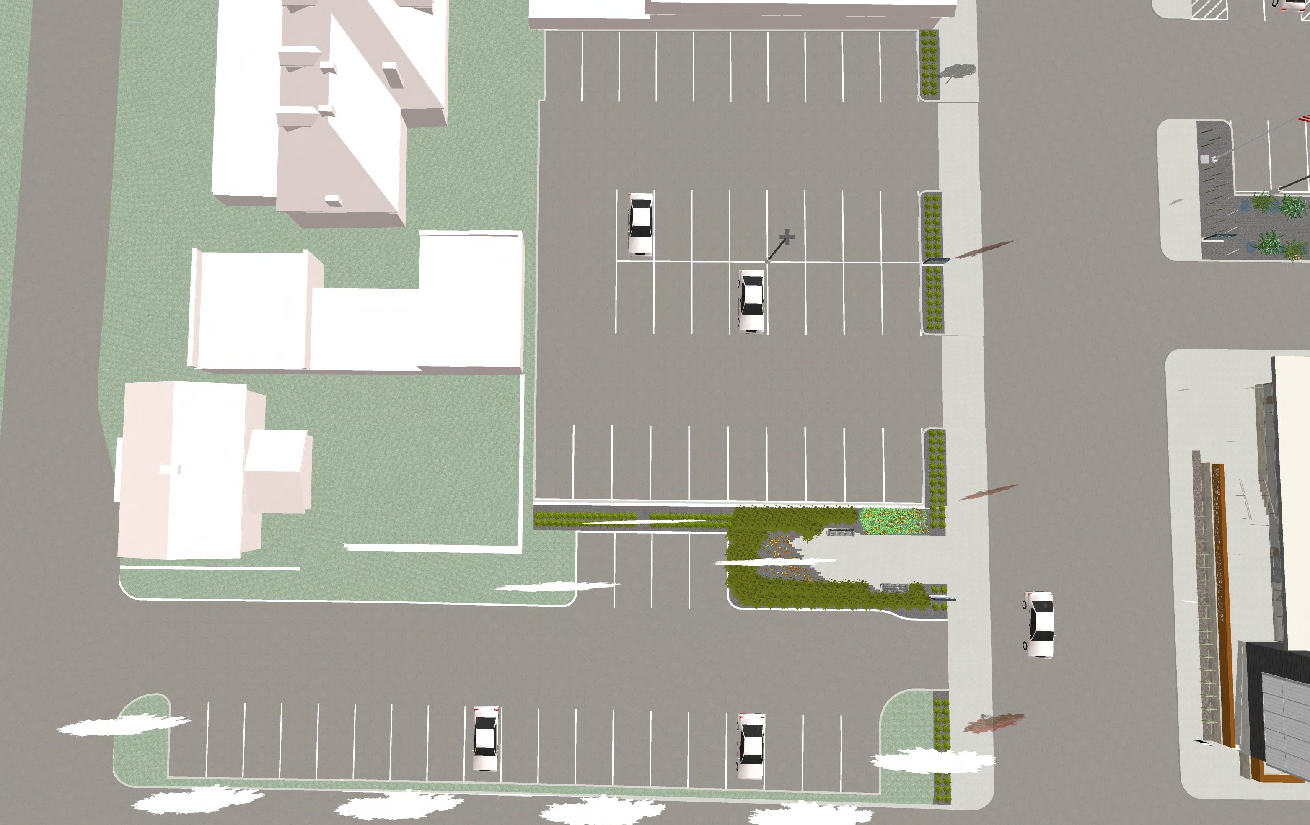
W COMMERCE STREET
W RACE STREET
OPTION A

Slide 6
THANK YOU

